Slide 1
Deep Learning: from Regression to Neural Networks

Slide 2
01
Introduction to Deep Learning

Slide 3
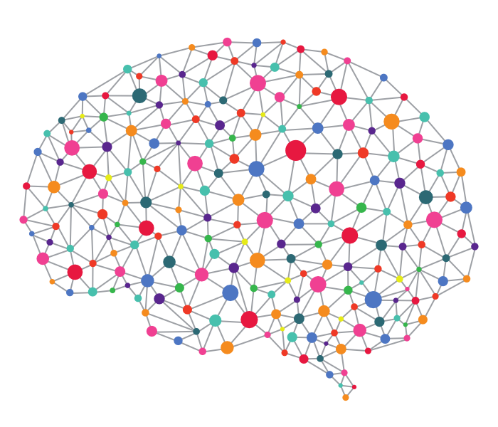
What is Deep Learning?
Deep learning is a subset of machine learning that uses artificial neural networks to automatically learn and understand complex patterns in data, enabling computer to do a variety of tasks like:
Speech Recognition
Object Detection
Language Translation

Slide 4
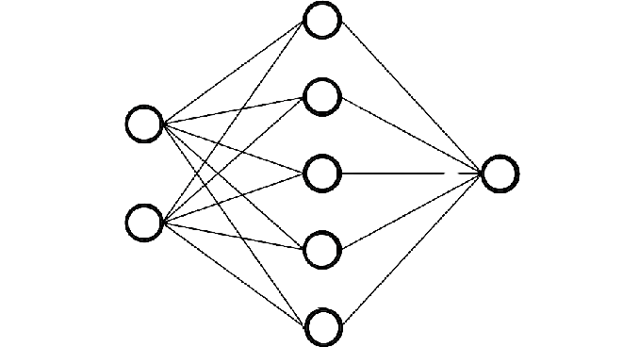
What are Neural Networks?
Neural Networks are computation methods inspired by the brain that can help us in many tasks, it has several types depending on the use case:
Feed forward (bare bone neural network)
Convolutional: Computer Vision
Recurrent: Sequence data
Transformers: example LLMs (Chatgpt)

Slide 5
02
Overview on Regression

Slide 6
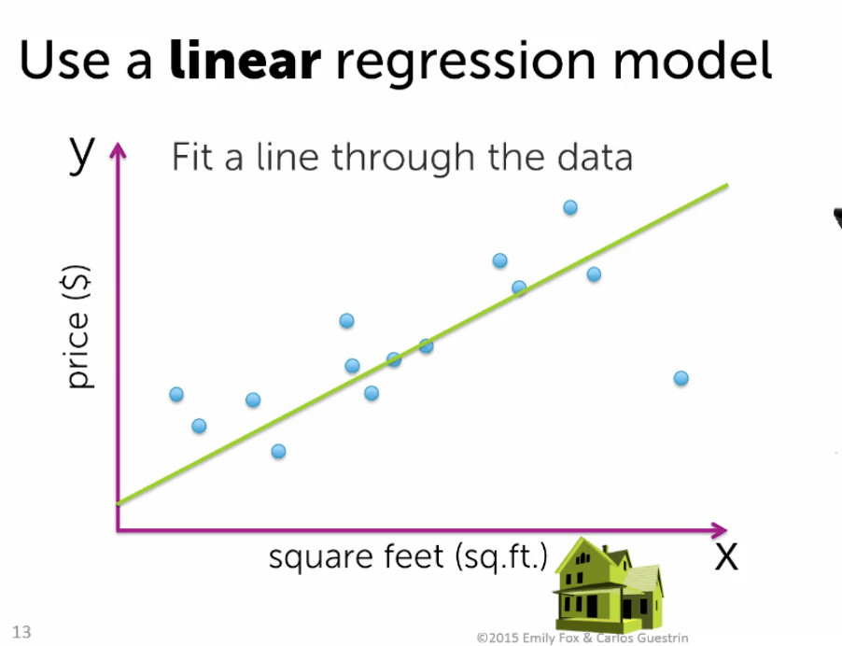
Linear Regression
Regression is the task for a computer to predict a number by fitting a curve through data. Its simplest form is linear regression.
How to fit the best possible line?
Get the line with that minimizes the cost/loss.
The cost/loss function can be thought of as a measure of how much our prediction is of
The loss function is the Mean Squared Error
Then apply an algorithm called the gradient descent.
Line parameters are initialized randomly

Slide 7
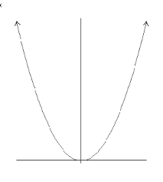
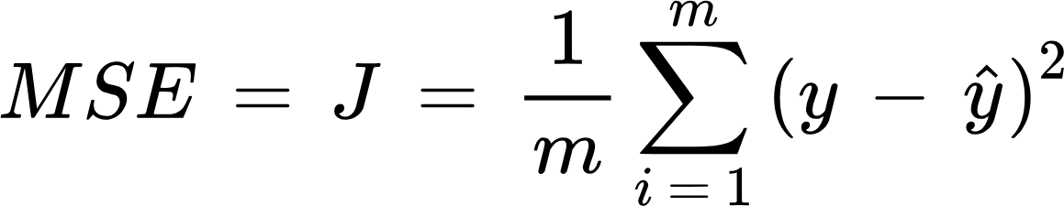
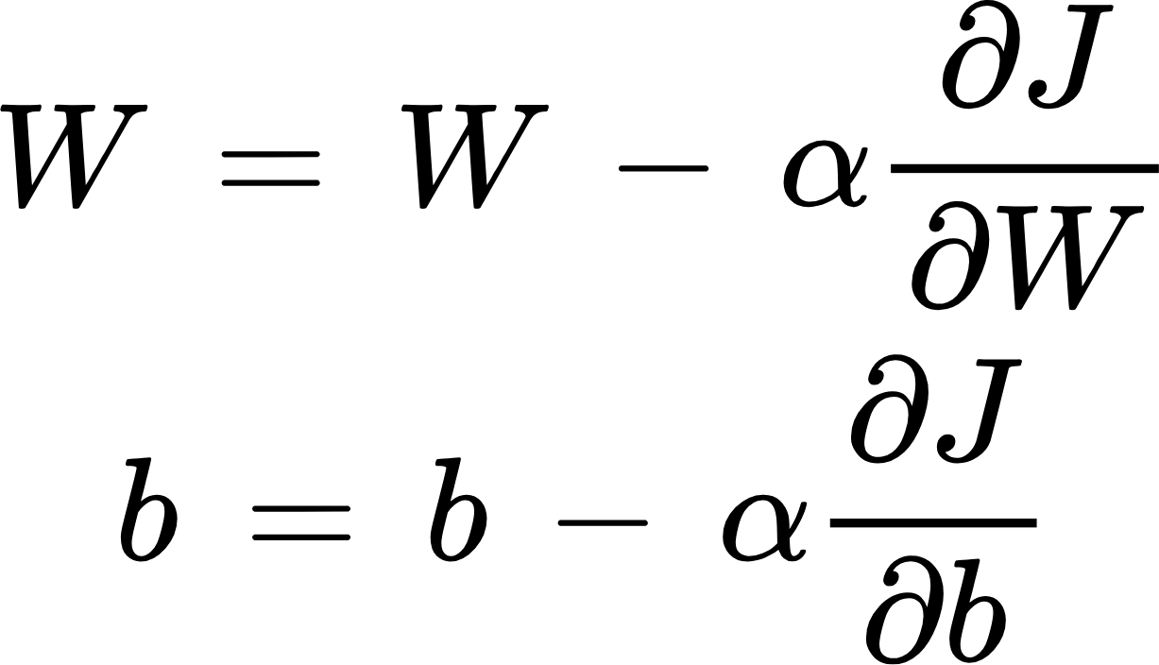
Gradient Descent
It is an iterative algorithm to get the best line
Update Rule
0.001 for example

Slide 8
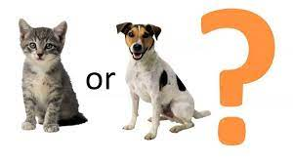
Logistic Regression
Classification is a task to determine for which class does a thing belongs to.
The algorithm is called Logistic Regression but used for classification!!
It uses a similar idea as linear regression but we change the cost function to binary cross entropy and we add an extra step after y to calculate the sigmoid function!!
Sigmoid can be interpreted as probability!

Slide 9
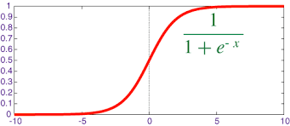
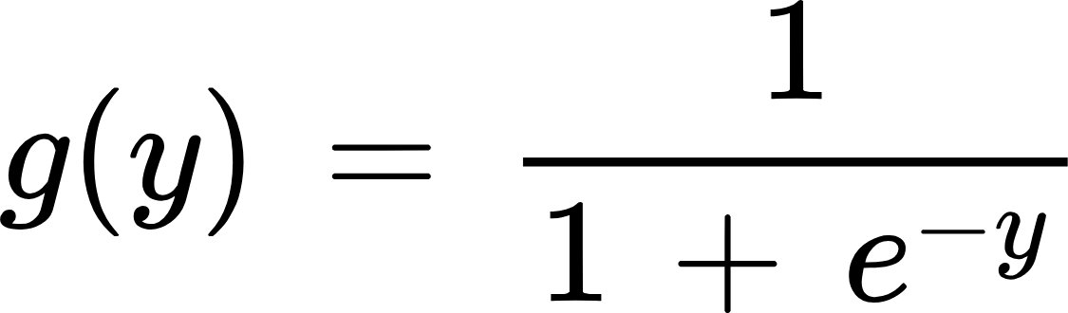
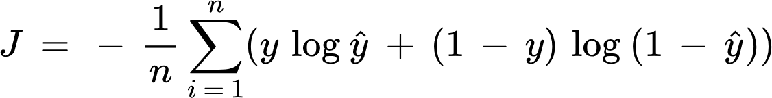
Logistic Regression
J is called Binary Cross Entropy
Update Rule

Slide 10
03
Structure of Feed Forward Neural Networks

Slide 11
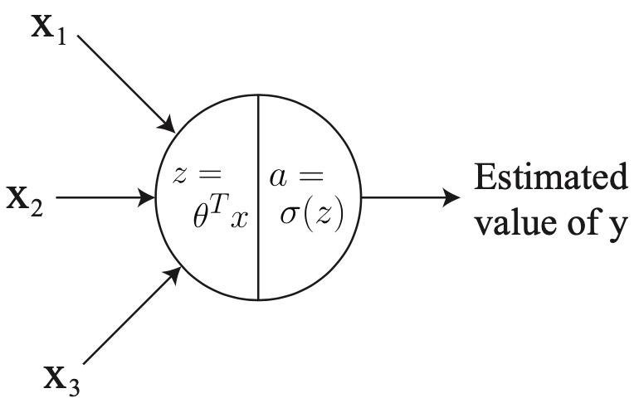
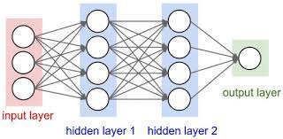
What is a feed forward neural network?
Any Observations?
Building neural networks is analogous to lego bricks
Take individual neurons and stack them together to create complex structures
Earlier layers tend to learn more simple patterns that later ones.

Slide 12
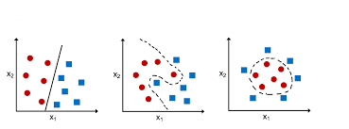
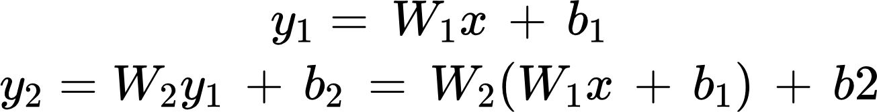
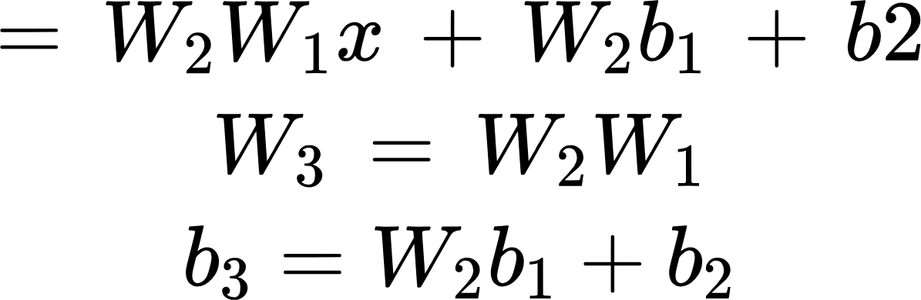
Problem
x
y1
y2

Slide 13
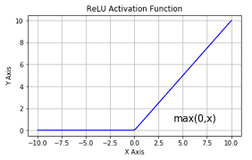
Solution: Activation functions
Activation functions in neural networks decide how much a neuron should 'fire' or send a signal. They help the network learn and understand complex patterns in data by adding flexibility and allowing it to solve a wide range of problems
So in conclusion it helps neural network learn more complex equations
Example
Sigmoid
Tanh
ReLu
Linear “No activation function”
By trial error it was found out that relu should be used for
all hidden neurons will the output we choose the activation function
depending on the scenario.

Slide 14
ReLu vs Sigmoid
An intuition why relu is better than sigmoid:
For large values sigmoid are approx. horizontal
This make the slope very very small
So we will need more steps to converge
So more time for the algorithm to run
The above is called the Vanishing Gradient Problem
However it is not better in all cases
As it can suffer from dying relu problem
So try both if needed!

Slide 15
04
How do Neural Networks work?

Slide 16
How do neural network train?
Initialize the parameters of each neuron randomly. Why?
To make different neurons learn different things
It can be initialized using the Xavier/He initialization
For each training iterations a neural network has 2 passes:
Forward pass:
Data is passed
Back propagation “training only”
Gradient are propagated in the other direction

Slide 17
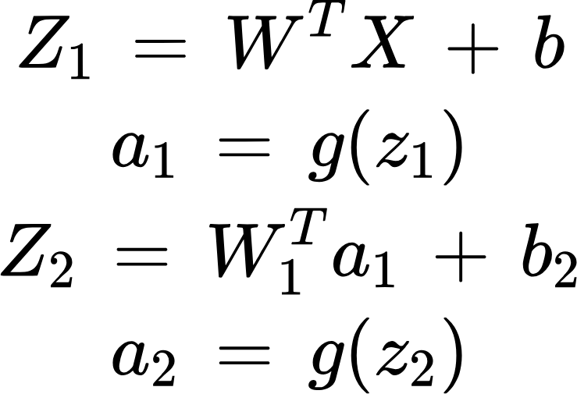
Forward Pass
We pass the data to the input layer
The layers keep passing their outputs to the next layer
The output layer produce the prediction
Note:
We write and implement the rules in vectorized forms to take advantage of the computational parallel power of the gpu
X
a1
a2

Slide 18
Back Propagation
Updates to the parameter are propagated in the opposite direction “gradients”
It uses gradient descent like normal linear and logistic regression
We start by computing the loss function
Then we calculate the derivative of the first node
Then to save calculations we use the chain rule (differentiation rule) to make faster calculations for the derivatives.

Slide 19
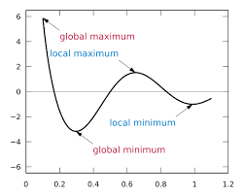
Problem with Neural Network
Optimization
In neural networks we use similar loss functions to normal linear regression and logistic regression
A problem arises is that now the output is not in linear form “not a linear function” due to the activation functions so our loss function does have a local minima(s) !

Slide 20
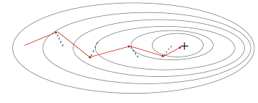
Optimizers
Optimizers are different algorithms that can be used to perform the back propagation step. Like gradient descent.
Its goal is to optimize the loss function and get the set of weights that will reach a local minimum “global not guaranteed”
Some type of optimizers
Stochastic Gradient descent
Mini batch gradient descent
Gradient descent with momentum
RMSprop
Adam

Slide 21
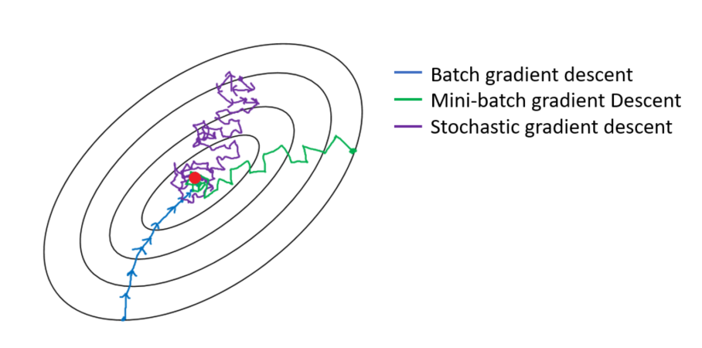
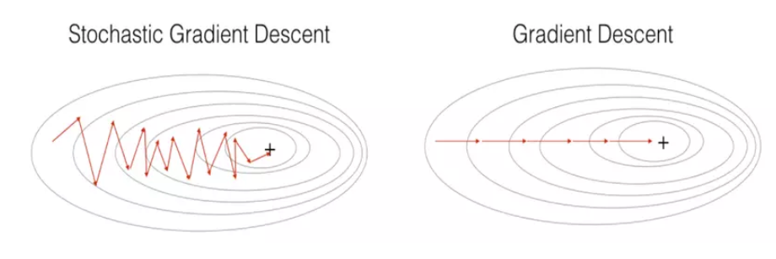
Stochastic vs Mini Batch Gradient Descent
Stochastic , Mini Batch and Normal Gradient descent are the same algorithm, the only difference is the chunk of the training set we look at before making an update
For stochastic we look at one training example before making a single step
For normal gradient descent we look at the whole data set
For mini batch gradient descent we look at m training examples
Where m is between 1 and the size of the training example
If m is equal to 1 it is equivalent to stochastic gradient descent
If m equal the size of the training example it is equal to gradient descent
They choice depends on the size of the training dataset
See the equation on the right, as we use a smaller batch in our update we get an approximation of the true J so we have a more noisy update

Slide 22
05
Classification Metrics

Slide 23
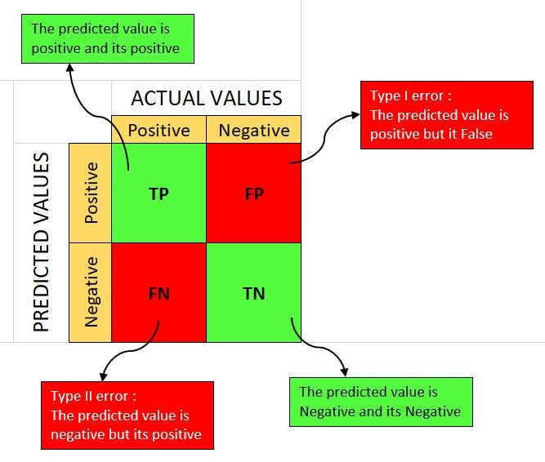
Confusion Matrix
The rows is what the algorithm predicted
The columns is the actual values
So What are TP, FP, FN, TN?
Assume Plague classification
True positives “TP”
Patients that are ill that was correctly identified by the algorithm
True Negatives “TN”
Patients that are healthy that was correctly identified by the algorithm
False Positives “FP / Type II Error”:
Patients that are healthy but was identified to be ill
False Negatives “FN / Type II Error”:
Patients that are ill but was identified to be healthy

Slide 24
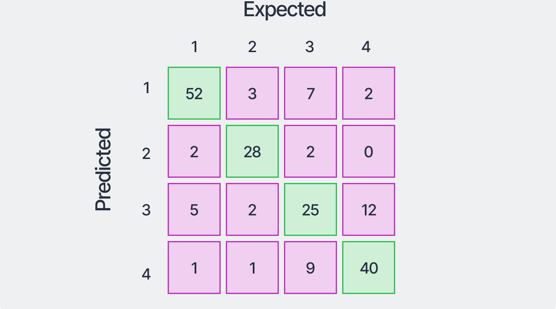
Bigger Confusion Matrix

Slide 25

Accuracy
This is the most intuitive performance measure
It is simply the ratio of correctly predicted observations to the total observations
Misleading for imbalanced data.
For example if for each 100 humans there is 1 person who have plague then our accuracy will be 99% when we predict everyone as healthy

Slide 26
Precision
It is the ratio of correctly predicted positive observations to the total predicted positive observations
In our plague example: The number of ill people that were predicted ill by our algorithm over the number of people that our algorithm predicted as ill
It is a reflection of the model’s ability to avoid labeling negative samples as positive.
A high precision mean that our model tries to predict the positive class only when it is likely to be correct
What concerns you the amount of false positives compared to the true ones
Useful to use when the cost of false positive is high “Type I error”

Slide 27

Recall
It is the ratio of correctly predicted positive observations to the total true positive observations
It tries to answer the question: Of all the actual positives, how many did we label correctly
A high recall indicates that the model is good at identifying the positive cases and has fewer false negatives
What concerns you the number of true positives compared to the number of false negatives
Useful when the cost of false negative is high “Type II error”

Slide 28
Precision Recall Trade-off
Example:
Imagine you're developing a machine learning model to identify potential outbreaks of a highly contagious disease like the plague. Your model examines various data points (symptoms in individuals, reported cases, environmental factors, etc.) and classifies each case as either "potential outbreak" (positive) or "no outbreak" (negative).
Precision tells us how many of the cases identified by the model as "potential outbreaks" are actually true outbreaks. High precision means that when the model predicts an outbreak, it's very likely to be correct.
Recall measures the model's ability to catch all actual outbreaks. High recall means the model successfully identifies most or all true outbreaks.

Slide 29
Precision Recall Trade-off
The Trade-off:
Assume our model produce a probability of having the plague or not and we have a threshold of 0.5 that if probability is >= 0.5 then the patient have the plague.
This probability is a bit loose as a lot of people having probability of 0.6, 0.7 could still be healthy but they are declared as ill “false positive”
However we have a wider range to catch any one who is ill so the number of false negative is low “false negative”
If we change our mind and our goal is to reduce the number of false positive “improve precision”. We increase the threshold to 0.999 which decreases the number of false positive significantly as now a lot of peoples will be declared healthy
But the false negative will increase significantly “worse Recall” as ill people with 0.99 probability will be declared healthy while they are ill.
So choose what to consider depending on your task 😉.
In this case Recall is more important to avoid a pandemic.

Slide 30
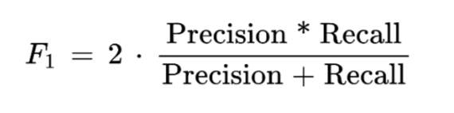
F1 Score
The harmonic mean of Precision and Recall
This is a useful metric when we need to balance between precision and recall “no clear preference between Type I and Type II errors”
More robust than accuracy with imbalance data
F1 score of 1 represent perfect precision and recall

Slide 31
THANK YOU!

